Slide 1
Default of credit card clients
By: Farzad Radmehr
Mentor: Joel N. Bangalan

Slide 2
Goals
This research aimed at the case of customers default payments in Taiwan and compares the predictive accuracy of probability.
Because the real probability of default is unknown, this study presented the novel Sorting Smoothing Method to estimate the real probability of default.
Simple linear regression result (Y = A + BX) will be applied.

Slide 3
Attribute Information
X1: Amount of the given credit (NT dollar): it includes both the individual consumer credit and his/her family (supplementary) credit. X2: Gender (1 = male; 2 = female). X3: Education (1 = graduate school; 2 = university; 3 = high school; 4 = others). X4: Marital status (1 = married; 2 = single; 3 = others). X5: Age (year). X6 - X11: History of past payment. We tracked the past monthly payment records (from April to September, 2005) as follows: X6 = the repayment status in September 2005;
X7 = the repayment status in August, 2005;
X11 = the repayment status in April, 2005. The measurement scale for the repayment status is: -1 = pay duly; 1 = payment delay for one month; 2 = payment delay for two months; 8 = payment delay for eight months; 9 = payment delay for nine months and above. X12-X17: Amount of bill statement (NT dollar).
X12 = amount of bill statement in September 2005;
X13 = amount of bill statement in August 2005;
X17 = amount of bill statement in April, 2005. X18-X23: Amount of previous payment (NT dollar). X18 = amount paid in September 2005;
X19 = amount paid in August 2005;
X23 = amount paid in April 2005.

Slide 4
Method
The purpose of this project, is to estimate a Logistic Regression Model to the credit card customers, so we can calculate the Probability of default based on the inputs. First, let’s call the data set and run it in R.

Slide 5
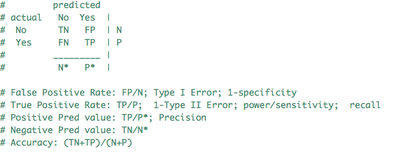
Overview
70 % of dataset is training and 30 % of it, is testing data.
The logistic regression model is applied.
The confusion matrix is build.
The equations and results are:

Slide 6


Results

